Slide 1

BoomBikes Bike Sharing System Data Analysis
Simran Satija
(student)

Slide 2
Objectives of the study and analysis
Prepare a proposal document with every intricate detail and workings of the entire project.
Analyse the data and do an exploratory analysis weighing in various factor.
Process data preparation and cleaning using python libraries.
Build a Linear Regression model using Machine Learning techniques to determine the best fit.
Thereby determining the best strategy for the business

Slide 3
Problem Statement
A bicycle-sharing system, bike share program, public bicycle scheme, or public bike share (PBS) scheme, is a shared transport service in which bicycles are made available for shared use to individuals on a short-term basis for a price or free.
Boom Bikes, a US bike sharing system faced considerable dip in the business when worldwide pandemic which has now made it difficult for the business to operate.
Now in order to tackle this, the company has decided to form a strategy which will be able to provide better and innovative services to their customers along with keeping a check on the acceleration of their revenue generation.

Slide 4
Data Information
Data set is in a csv form.
Data set consists of data of span of 2 years (2018 & 2019)
Data shape = 730 rows and 16 columns
It has size of 56.1Kb
Data columns are: instant', 'dteday', 'season', 'yr', 'mnth', 'holiday', 'weekday', 'workingday', 'weathersit', 'temp', 'atemp', 'hum', 'windspeed’, ‘casual', 'registered', 'cnt'

Slide 5
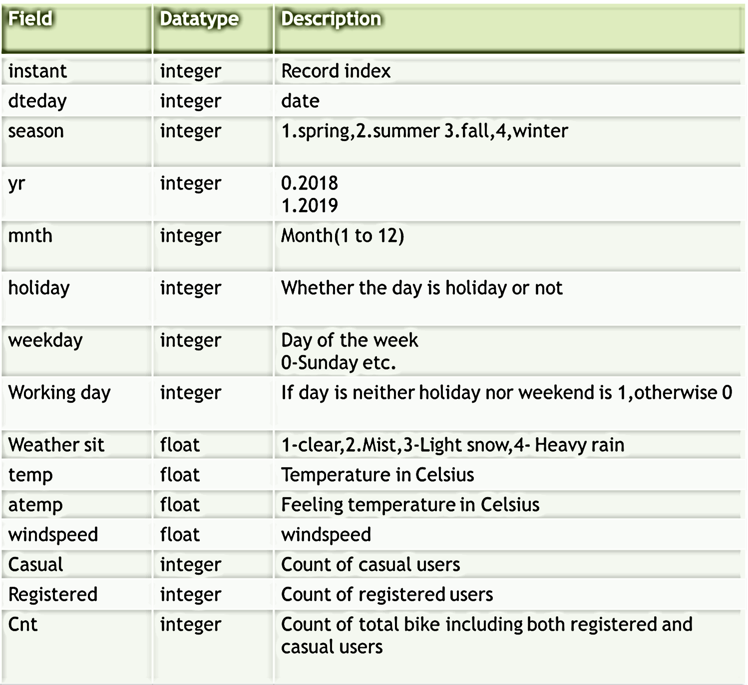

Slide 6
Tools Used
Jupyter Notebook
Python and Libraries: pandas, matplotlib, seaborn, joblib, NumPy and Scikit-learn.
Machine learning tools

Slide 7
Exploratory Data Analysis (EDA)
At what time and month in a year does the bike demand spikes?
At what temperatures people prefer to use the bike service?
In which season does the demand usually goes up?
On which day of the week is the bike demand usually high?
Does the bike demand vary much on nationwide holidays in a year as compared to nonholidays?
Does the bike demand vary on weekends as compared to weekdays?
How many bikes a used on casual basis?
How many bikes are used on a registered basis?
In which year was the bike demand more?

Slide 8
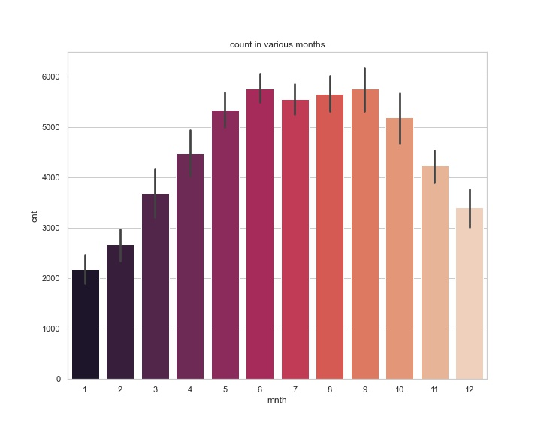
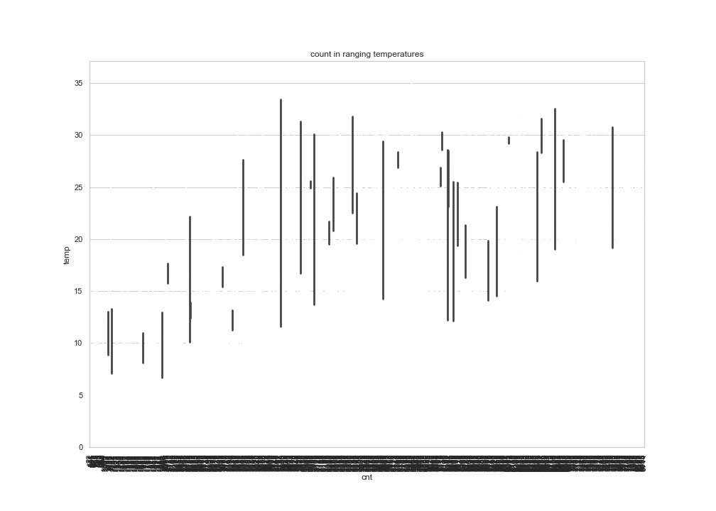
MAXIMUM NUMBER OF BIKES UTILIZED IS IN THE MONTHS OF JUNE AND SEPTEMBER
MAXIMUM NUMBER OF BIKES UTILIZED IS IN HIGHER TEMPERATURES.

Slide 9
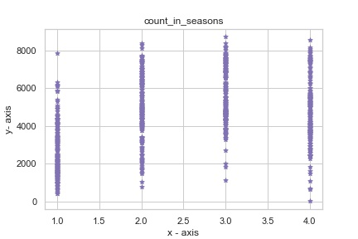
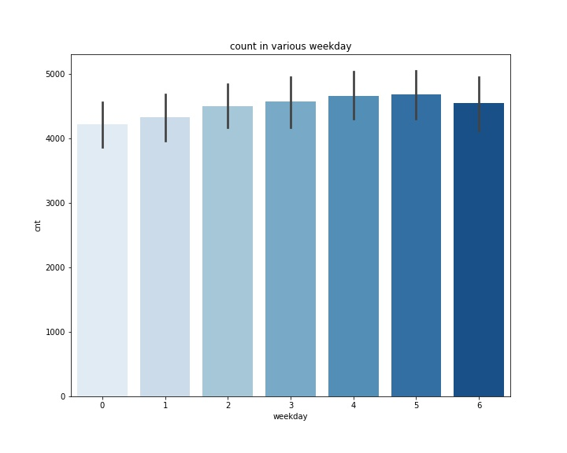
MAXIMUM NUMBER OF BIKES UTILIZED IS IN THE THIRD SEASON
MAXIMUM NUMBER OF BIKES UTILIZED IS ON THE 5TH DAY OF THE WEEK I.E. FRIDAY

Slide 10
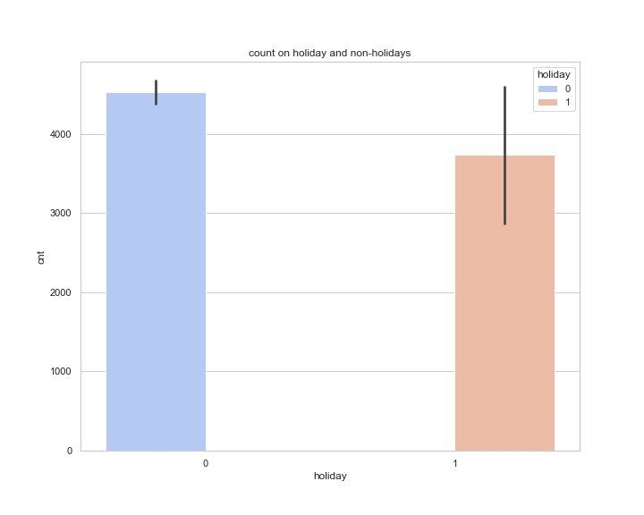
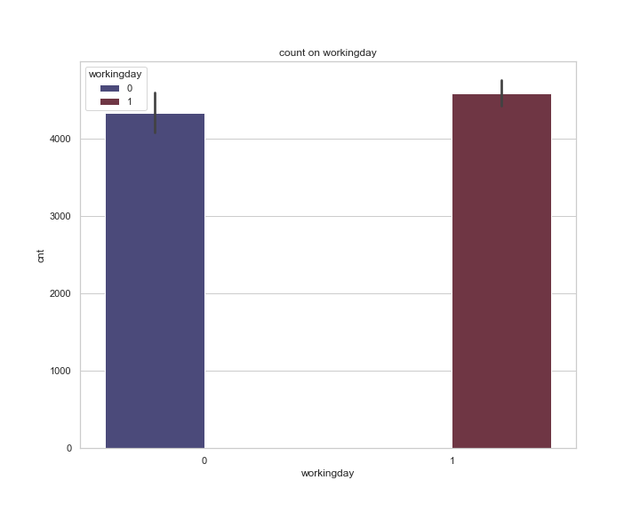
MAXIMUM NUMBER OF BIKES UTILIZED IS ON HOLIDAYS. ALSO THIS DATA HAS IN ALL 21 HOLIDAYS IN 2 YEARS, HENCE MORE BIKES ON HOLIDAYS IS A LOT IN COMPARED TO NON-HOLIDAYS
MAXIMUM NUMBER OF BIKES UTILIZED IS ON WORKING DAYS

Slide 11
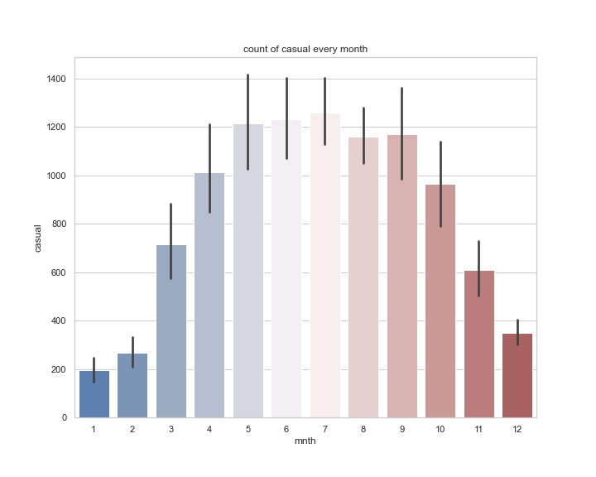
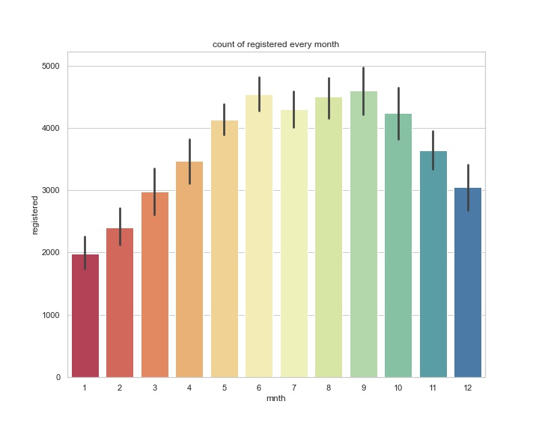
MAXIMUM NUMBER OF CASUAL BIKES UTILIZED IS IN THE MONTH OF JULY
MAXIMUM NUMBER OF REGISTERED BIKES UTILIZED IS IN THE MONTH OF SEPTEMBER

Slide 12
Machine Learning Model
Multiple Linear Regression Model used.
To determine the relationship between dependent and independent variables in data set, in order to know how the count of bikes used varies depending on weekdays, weekends, holidays, temperature month, season, etc.
Independent variables = predictor columns=['season', 'yr', 'mnth', 'holiday', 'weekday','workingday','casual', 'registered’]
Dependent variables = target columns=['cnt’]
Model testing and using mean absolute error, mean square error, Root mean square error and R2 to evaluate the model.
Test size is 40%
Test data : 292 observations
Train data :438 observation

Slide 13
Error Matrices
Mean squared error(MSE)
train data- 1.328763583182056e-12((~0)
Test data-1.2437417914441863e-12 (~0)
Root mean squared error(RMSE)
train data- 2.6385333129628562e-24(~0)
Test data- 2.3370795771593e-24(~0)
Mean absolute error(MAE)
Train data- 1.6243562764870446e-12(~0)
Test data- 1.5287509859880058e-12(~0)
Ordinary least square error/R2
Train data-1
Test data-1

Slide 14
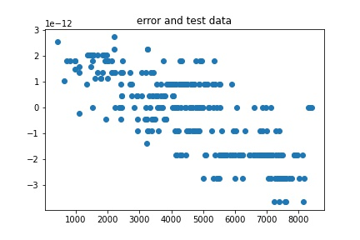

Slide 15
THANK YOU

